Slide 1

Parallel SSSP Update in Large-Scale Dynamic Networks
Exploring efficient, parallel algorithms for updating shortest paths dynamically.

Slide 2

Problem Statement: Dynamic Networks
Network Dynamics
Edges frequently inserted or deleted in social, road, and communication networks.
Computational Challenge
Recomputing shortest paths from scratch is expensive and redundant.
Objective
Update Single-Source Shortest Paths (SSSP) efficiently without full recomputation.
Scaling Challenge
Must scale efficiently on large graphs using parallel computing platforms.

Slide 3
Proposed Parallel Framework
Platform Independence
Two-Step Algorithm
Works on shared-memory CPUs (OpenMP) and GPUs (CUDA/OpenCL).
Detect affected subgraphs from edge changes.
Update these subgraphs iteratively to stabilize distances.

Slide 4

Algorithm Overview
Tree Data Structure Use
Lock-Free Approach
Iterative Updates
Converges via comparisons instead of synchronization locks.
Efficient representation of SSSP for localized updates.
Identify Affected Subgraphs
Traverse affected vertices to relax distances until convergence.
Parallel detection of edges impacting shortest path tree and distances.

Slide 5
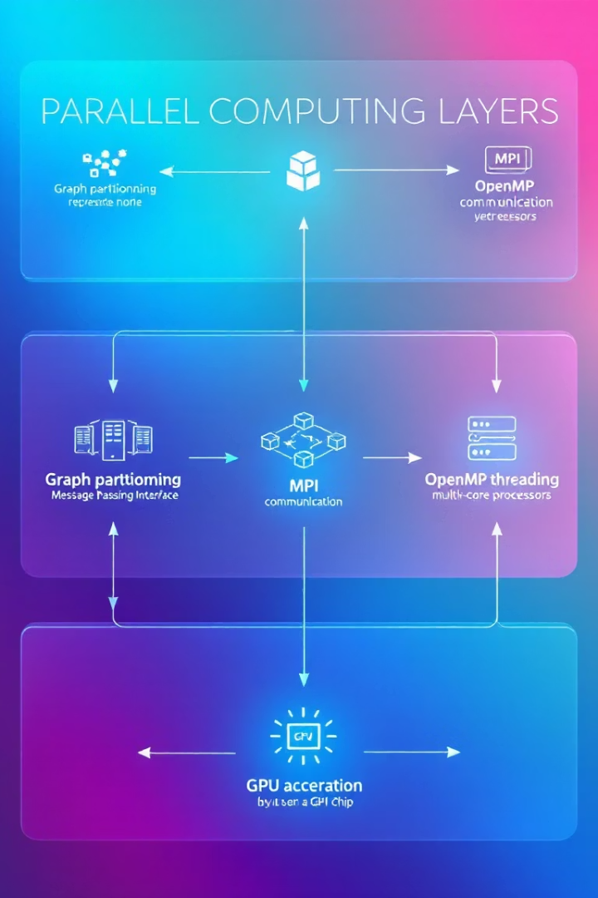
Parallelization Plan
Graph Partitioning (METIS)
Balanced graph chunk division to reduce communication.
Inter-node Communication (MPI)
Distribute graph partitions efficiently across processes.
Intra-node Computation (OpenMP)
Use threads to run update steps in parallel on CPU.
GPU Acceleration (OpenCL)
Data-parallel kernels speed up computation on GPUs.

Slide 6

Implementation Details
Technology Stack
Modular Design
C++ with MPI and OpenMP
Distinct files for vertex identification and tree updates.
METIS for graph partitioning
Data Structures
Store SSSP with Parent[], Dist[], and Affected[] arrays.

Slide 7
Scalability Evaluation
Metrics
Datasets
Experiments
Execution Time
LiveJournal
Vary number of processes and threads
Speedup vs Sequential
Orkut
Weak and Strong Scaling
RMAT-24
Test batches of edge insertions/deletions
BHJ

Slide 8

Expected Results & Next Steps
Expected Results
Limitations
Next Steps
Significant speedup over sequential Dijkstra for large graphs.
Performance drops if >75% of graph updates or many deletions.
Finalize code integration
Conduct scalability tests
Prepare final demo and report

